Slide 1
Week 1
IMU

Slide 2
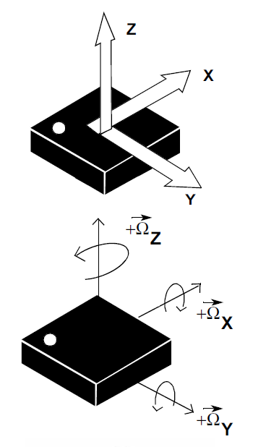
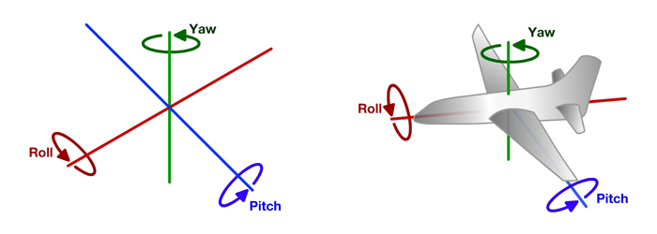
IMU Intro

Slide 3
Today: IMU
Goal: measure quad pose
Wire IMU to PI
Getting gyro / accel data
Convert raw data to useful format
Getting roll and pitch angle from Accel.
Gyro and Angle Calibration – Milestone1
Complementary filter graphs– Milestone 2

Slide 4
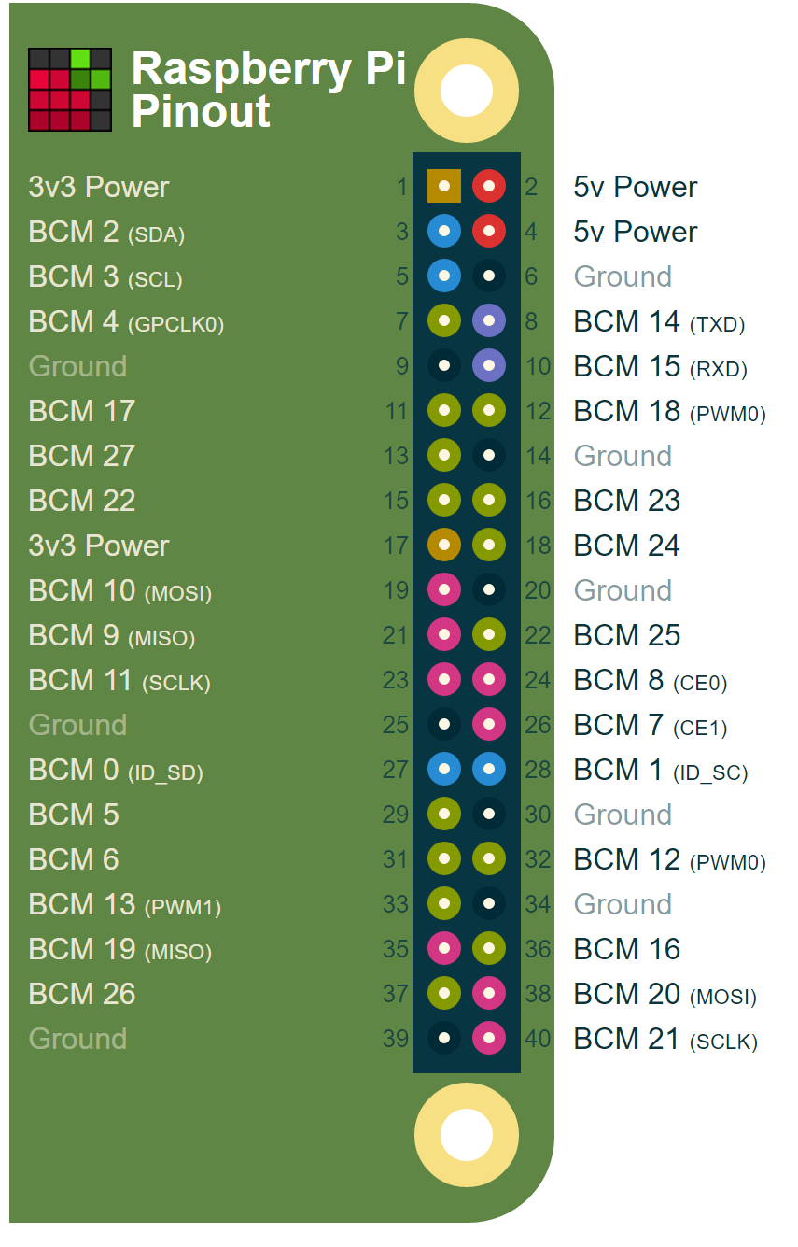
Wire IMU to PI
VDD(on IMU)->3.3V on Pi
GND(on IMU)->GND on Pi
SDA and SCL on IMU to same pins on Pi
Use I2C port 1
Before powering on, ask me if you are unsure
You will make me sad if you destroy IMU :(
You will make me sad if you destroy the PI :(
Don’t let IMU touch PI
You will make me sad if you destroy IMU :(
You will make me sad if you destroy the PI :(
Don’t let IMU or PI touch any metal surface
You will make me sad if you destroy IMU :(
You will make me sad if you destroy the PI :(
Don’t bend wires, they will break.
NEVER connect/disconnect wires when system is powered!!

Slide 5
Setup
Place sd card in PI
Attach wifi dongle to usb port marked USB
When ready to power (after checking with me) attach usb cable to “power” port and to computer.
For computers with “AC” wireless, after about 15 seconds of power, you should be able to see a ssid of “quadX” where X is a number 00, 01, 02 .., corresponding to the number on the sd card
Connect with password “quadXX”
For example, if your quad is “quad02”, use “quad0202” as your password
Dhcp should be set as “automatic”

Slide 6
More Setup
Ssh into pi at
192.168.0.1 user:pi password:raspberry
Windows users suggested to use mobaxterm program (need to download)
Keep all your files in the flight controller directory
Compile code
gcc –o name name.cpp –lncurses –lwiringPi -lm
Run code
sudo ./name
Test imu is connected by running :
I2cdetect –y 1
You should detect something connected at address 68

Slide 7
DEMO

Slide 8
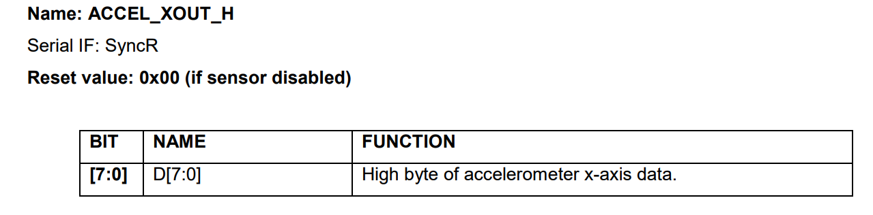
I2C interface
Each device has an address (IMU=0x6B)
Read/write memory locations
Example from data sheet

Slide 9
Reading to I2C
Connect to I2C address:
Int imu=wiringPiI2CSetup(0x6B);
Raw Z rate values are at locations 63 and 64
Read it :
High_z=wiringPiI2CReadReg8(imu,63)
Low_z=wiringPiI2CReadReg8(imu,64)
Combine values and take 2’s complement
Now values range from -32768 to +32767 … what does this mean?

Slide 10
Convert to “G’s”
What is our acceleration range?
Hint look at address in datasheet
Default Range is +-2 g
So -32768 to +32767 corresponds to -2 to +2 g

Slide 11
Convert to degrees / sec
What is our sensed angular velocity range?
Hint look at address in datasheet
Range is +-? (degrees/second)
So -32768 to +32767 corresponds to -500 to +500 dps

Slide 12
Drift
When stationary, what is the gyro output supposed to be?

Slide 13
Drift
When stationary, what is the gyro output supposed to be?
Find average stationary value over 1000 samples in calibrate_imu() subtract from gyro output in read_imu() so stationary value is very close to zero.
Do this for all 3 gyro DOF
Use x_gyro_calibration, y_gyro_calibration, z_gyro_calibration global variables

Slide 14
Getting Pitch and Roll
Get acceleration in X,Y,Z;
Convert to G’s
Use Y,Z values to compute angle of rotation on X (roll)
Hint:atan2(y,z) then convert to degrees
Check signs, gyro and accel should match, i.e. if gyro is +, accel angle should be getting bigger
If using math, also include the –lm flag
Use X,Z values for rotation on Y(pitch)

Slide 15
Pitch and Roll Calibration
What are pitch and roll values supposed to be when flat on table?
note: this is when the wire side of imu is facing down

Slide 16
Pitch and Roll Calibration
What are pitch and roll values supposed to be when flat on table?
Find average flat value in calibrate_imu() over 1000 samples, subtract from pitch and roll values in read_imu() so stationary value computed by the accel. is very close to zero.
Use roll_calibration, pitch_calibration global variables

Slide 17
Milestone 1
Print calibrated values to screen; 3 gyro values, roll, pitch (use printf) every call of read_imu() sample. Print the values continuously.
Make format readable
All in one line / reading, nice spacing

Slide 18
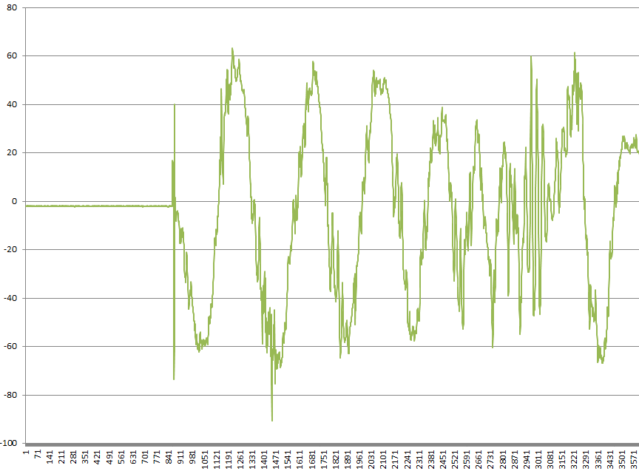
Pitch and Roll problems
Accel- Accurate over long term, noisy over short term

Slide 19
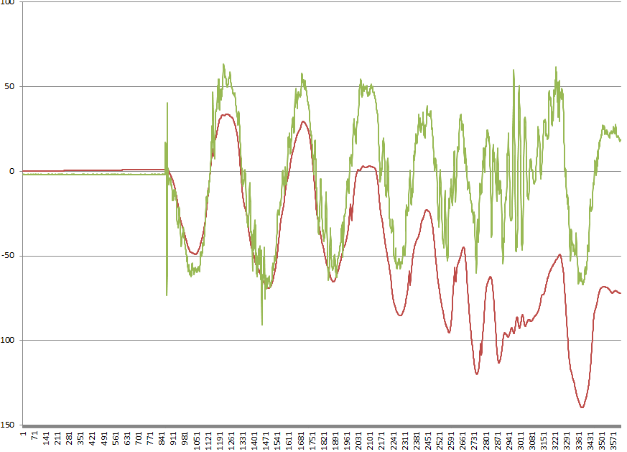
Pitch and Roll problems
Integrated Gyro-Little noise over short term, drifts over long term

Slide 20
Pitch and Roll problems
Use both accel and gyro
use the low noise of the gyro, but long term accuracy of the accelerometer.
High pass gyro + low pass accel
Complementary filter, every time step update:
Roll=roll_accel*A+(1-A)*(roll_gyro_delta+Roll),
Where A << 1 (try .02)
Note: Make sure signs match, a + gyro rate should give a + increase in accel. angle.

Slide 21
Rate vs angle
Note filter uses roll_gyro_delta, but gyro just gives roll velocity, How to convert?

Slide 22
Rate vs angle
Note filter uses roll_gyro_delta, but gyro just gives roll velocity, How to convert?
roll_gyro_delta=roll velocity * Delta t
Update_filter computes time since last called, use this as your Delta t

Slide 23
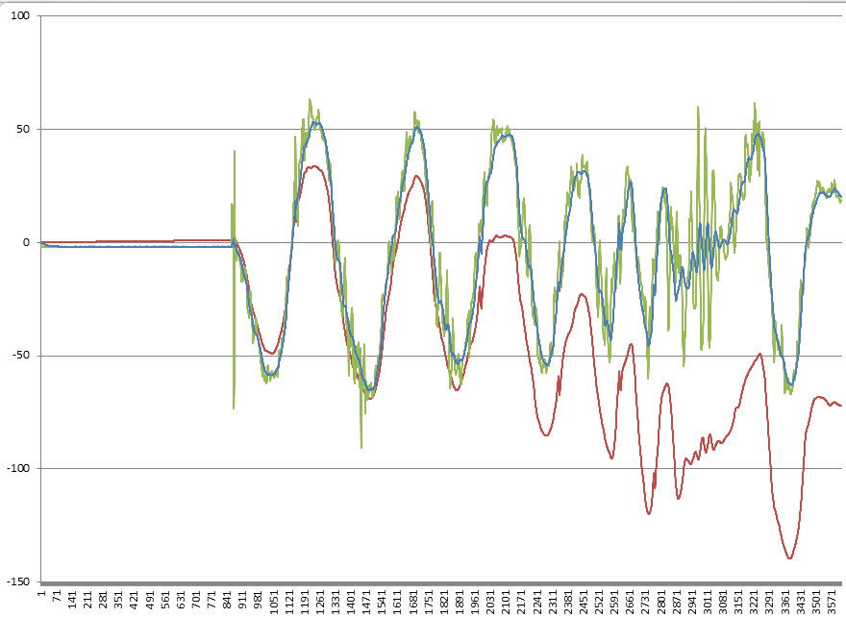
Complementary Filter

Slide 24
Milestone 2
Create a graph showing: output of final comp. filter, roll angle computed by accel, and integrated gyro output for roll (all on 1 graph vs time).
Scale gyro output so its visible on graph
Move the imu around gently during data capture
Create a second graph for pitch
Hint: easy way to do this is to print out data to screen using printf, copy to text file, import text file into excel and plot
Note: Be sure to download all files you made in class off the PI.. You’ll need them for your weekly submissions

